Slide 1

McDigest
Mining McDonald's Store Reviews
Group 8 - OPIM 5671: Text Mining Group Project

Slide 2
BUSINESS PROBLEM
Comprehensive Feedback Analysis
Understanding Regional Customer Preferences and Pain Points
Tailored Marketing and Operational Strategies
Page - 1

Slide 3
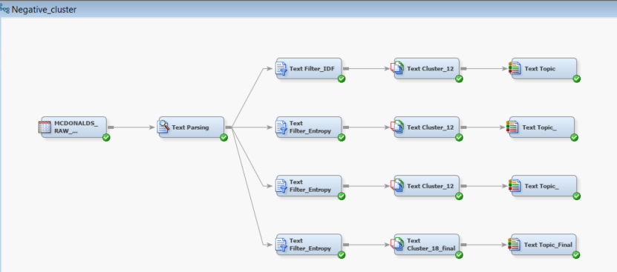
NEGATIVE FEEDBACK MODELING
Page - 2

Slide 4
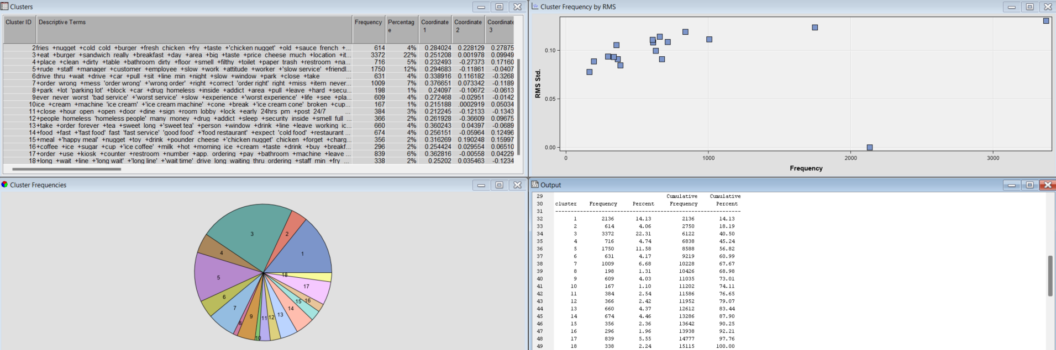
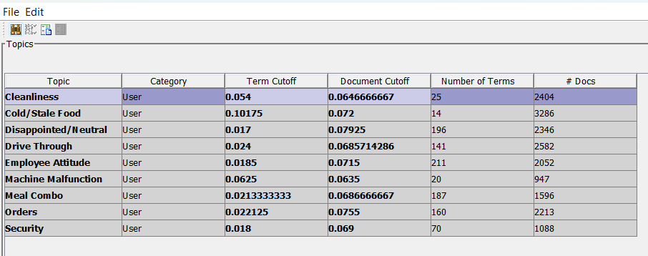
NEGATIVE FEEDBACK MODELING - Clusters and Topics
TEXT CLUSTER
TEXT TOPIC
Here are clear examples of clusters into topics:
Clusters 4,8,12 clearly pulls together the topics Cleanliness and Security
Clusters 3, 15 add up to topic Meal Combo(24%)
Clusters 2, 14 add up to cold/stale food
Clusters 10, 16 add up to Machine Malfunction
Page - 3

Slide 5
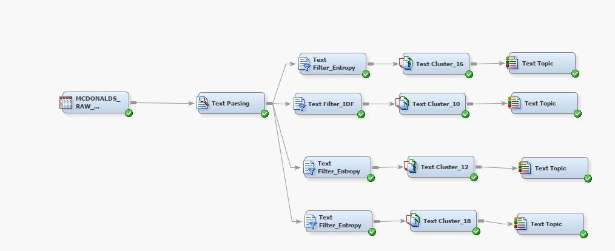
POSITIVE FEEDBACK MODELING
Page - 4

Slide 6
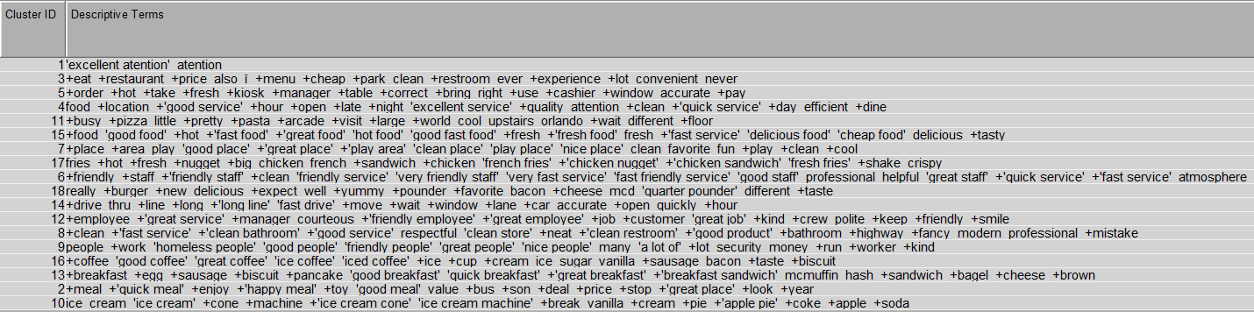
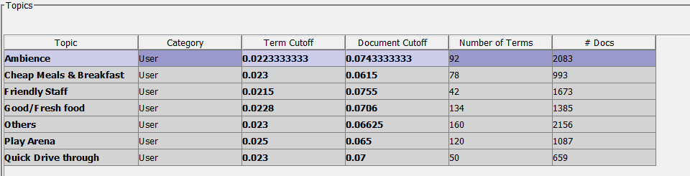
POSITIVE FEEDBACK MODELING (RESULTS)
TEXT CLUSTER
TEXT TOPIC
Here are clear examples of clusters into topics:
Cluster 11 highlights customer satisfaction with the pasta and pizza offerings.
Cluster 18 reflects positive feedback specifically for the Quarter Pounder with Cheese.
Cluster 7 points out the play arena as a notable feature that customers appreciate.
Page - 5

Slide 7
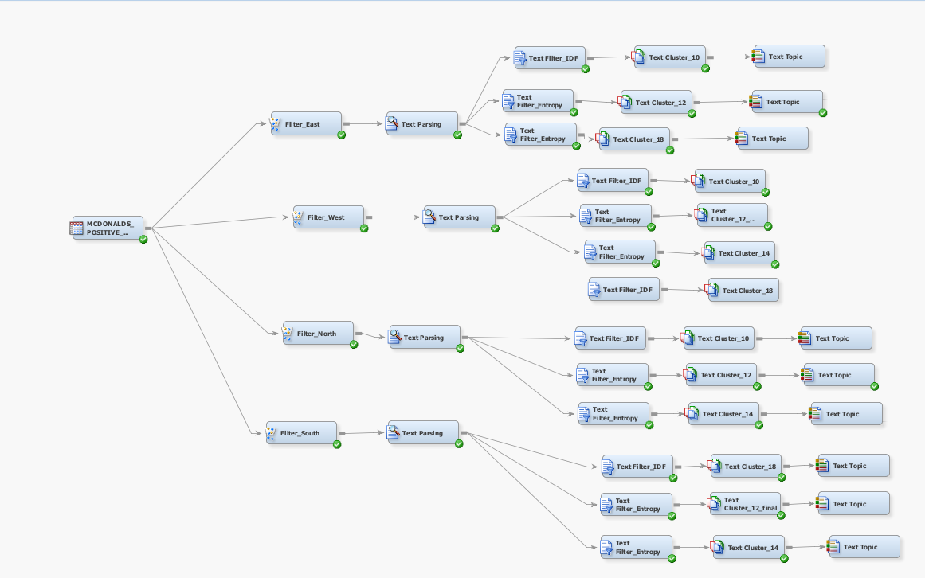
REGION-WISE POSITIVE REVIEWS MODELING
Page - 6

Slide 8
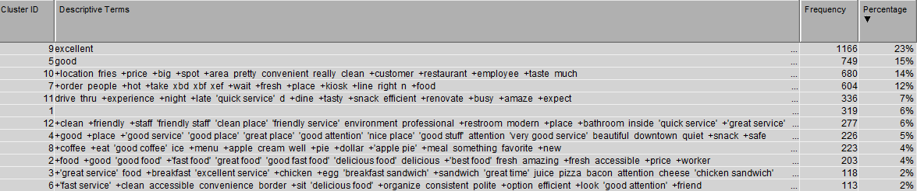
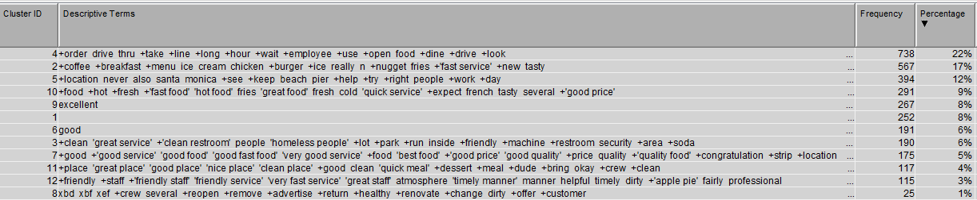
REGION-WISE POSITIVE REVIEWS CLUSTERING
EAST
Basically , East with most locations out of all in the dataset, contributed equally for all the topics identified in the positive analysis. However, within cluster ID 8, a specific mention of apple pie is worth mentioning.
WEST
Majority contribution is focusing on drive- through, and it being quick and fast however we had to checkout, parking, as it portrays a negative sentiment in even in positive reviews.
Page - 7

Slide 9
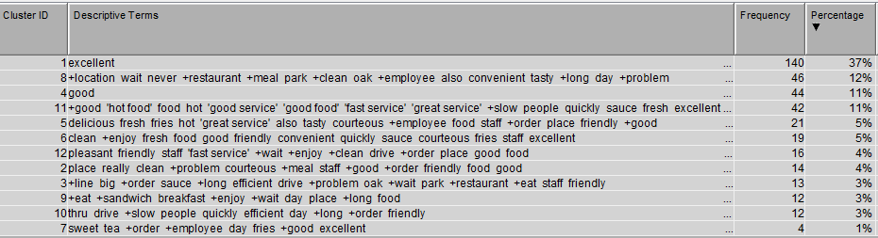
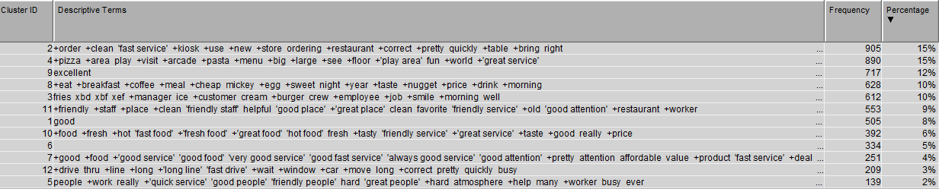
REGION-WISE POSITIVE REVIEWS CLUSTERING
NORTH
The quality of food and service in this region stands out, with no additional areas of concern identified.
SOUTH
Our analysis of Cluster ID 4 revealed that this region hosts the largest McDonald's in the world, featuring a play area and an arcade. Additionally, this location distinguishes itself by offering pizza and pasta on its menu.
Page - 8

Slide 10
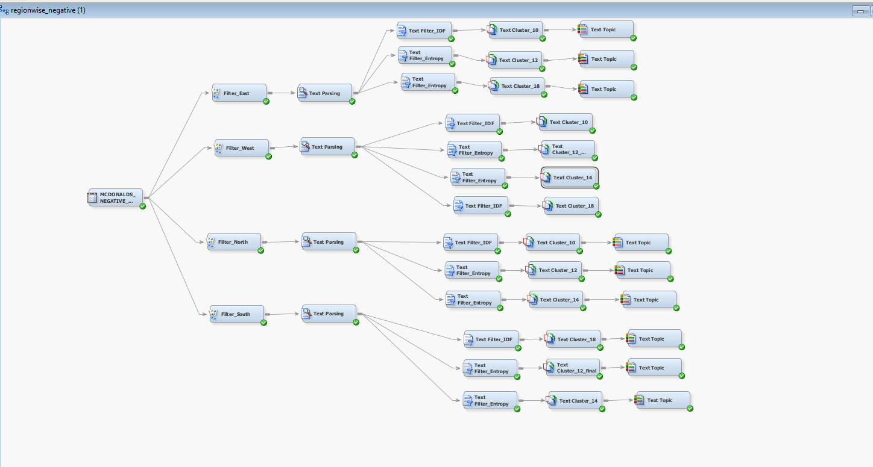
REGION-WISE NEGATIVE REVIEWS MODELING
Page - 9

Slide 11
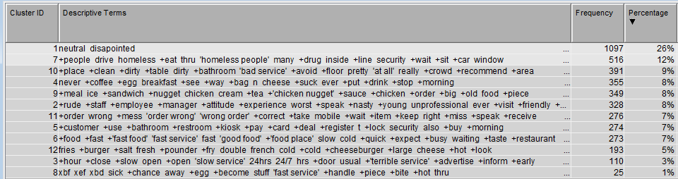
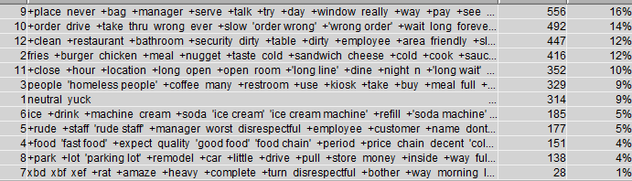
REGION-WISE NEGATIVE REVIEWS CLUSTERING
EAST
The primary dissatisfaction among customers in the East relates to cleanliness and security, accounting for 26% of feedback with 1,104 mentions. Clusters 7,10, and 5 specifically highlight these concerns.
WEST
In the West, the most significant issues are with the drive-through service, as identified in clusters 9 and 10, which have the highest frequency. This is followed by concerns about cleanliness (12%, cluster 12) and meal quality (12%, cluster 2).
Page - 10

Slide 12
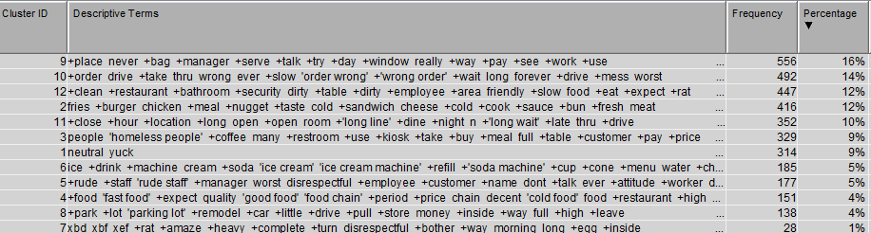
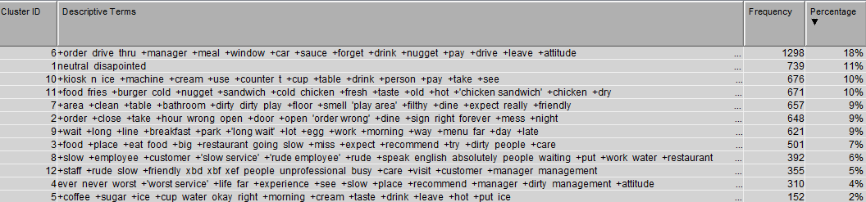
REGION-WISE NEGATIVE REVIEWS CLUSTERING
NORTH
The North region presents a mostly neutral perspective. However, specific issues are noted, including poor management at Oak Park. Unavailability of tables leading customers to overcrowded drive-throughs.
SOUTH
The South faces the largest number of complaints about drive-through service, followed by issues with faulty machines (12%, cluster 10) and cold food (10%, cluster 11), equally impacting customer satisfaction.
Page - 11

Slide 13
BUSINESS RECOMMENDATIONS
Eastern Region
Cleanliness and Security
Western Region
Parking and Drive-Through Efficiency
Northern Region
Food Quality and Order Accuracy
Southern Region
Employee Training and Machine Maintenance
Page - 12
Notes:
Eastern Region:
Cleanliness and Security: Implement daily cleaning schedules for bathrooms and dining areas, with additional staff assigned during peak hours. Install security cameras and increase security patrols to deter drug-related activities. Collaborate with local organizations to address homelessness issues around premises, potentially through outreach programs or partnerships.
Western Region:
Parking and Drive-Through Efficiency: Explore options for expanding parking facilities or optimizing existing space to accommodate more vehicles. Extend drive-through service hours to operate 24/7 as advertised, ensuring adequate staffing levels for overnight shifts. Introduce mobile ordering options to reduce wait times and enhance order accuracy. Implement regular customer service training programs to improve interactions and address issues of rudeness.
Northern Region:
Food Quality and Order Accuracy: Provide additional training for management teams, particularly in locations like Oak Park, to improve operational efficiency and ensure consistency in service standards. Conduct regular equipment maintenance checks to prevent ice cream machine malfunctions. Enhance quality control measures to address complaints about cold or stale food and inaccuracies in orders.
Southern Region:
Employee Attitude and Machine Maintenance: Develop a comprehensive employee training program focusing on customer service skills, with a specific emphasis on drive-through interactions. Implement performance metrics to monitor employee attitudes and provide feedback for improvement. Establish a preventive maintenance schedule for machines to reduce instances of malfunctions, potentially involving more frequent servicing or equipment upgrades.

Slide 14
McThankYou
Satakshi Deshmukh
Hema Pradhiksha Dhanapal Rohit Kamineni
Sravya Machavarapu
Sri Kavya Reddy Narra

